Slide 1


CONTENT
01
ABOUT PROJECT
02
OUR TEAM
03
GOALS/TARGETS
04
METHODOLOGY
05
INSIGHTS
06
ANALYSIS
07
CHALLANGES
08
CONCLUSION

Slide 2





ABOUT PROJECT
We have worked upon the data fetching, cleaning and analysing and visualization from the website ‘Naukri.com’
We were able to achieve our desired results wherein we analysed the number of jobs in different sectors among different locations.

Slide 3
OUR TEAM
Vidita Pawan
Altaf Mulani
Rishabh
Sharma
Rishabh Chugh

Slide 4





GOALS AND OBJECTIVES
Our goals towards the making of this project were--
Employee - User should have ease to choses the best job available.
Insights -
Some insights for clients to analyze, which job is more in demand.
Getting info about job vacancies in different sectors across different geographic and demographic locations.

Slide 5


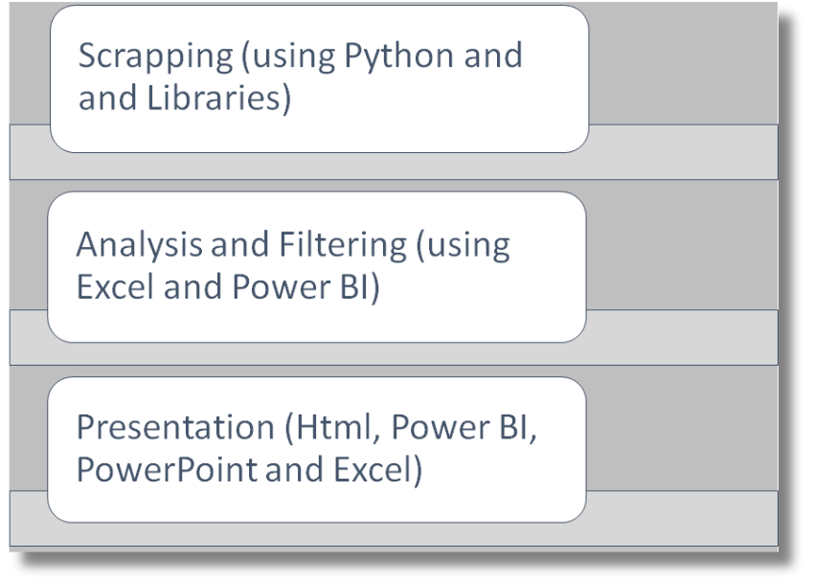
Project Execution
(Methodology):

Slide 6

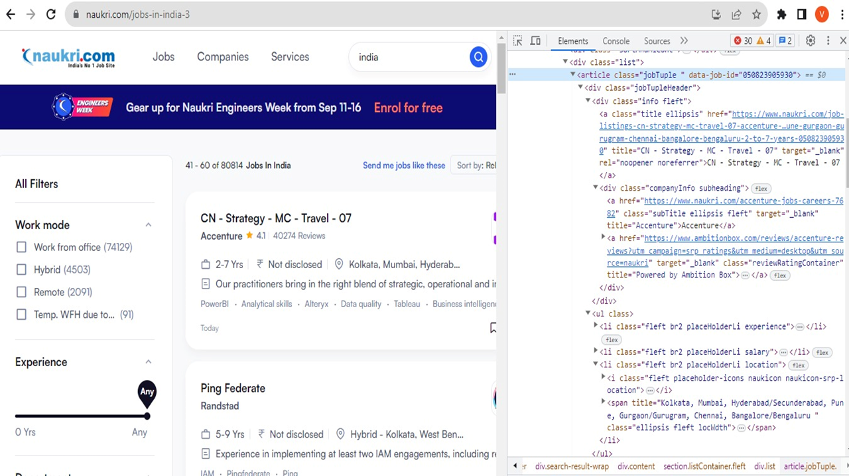

Slide 7

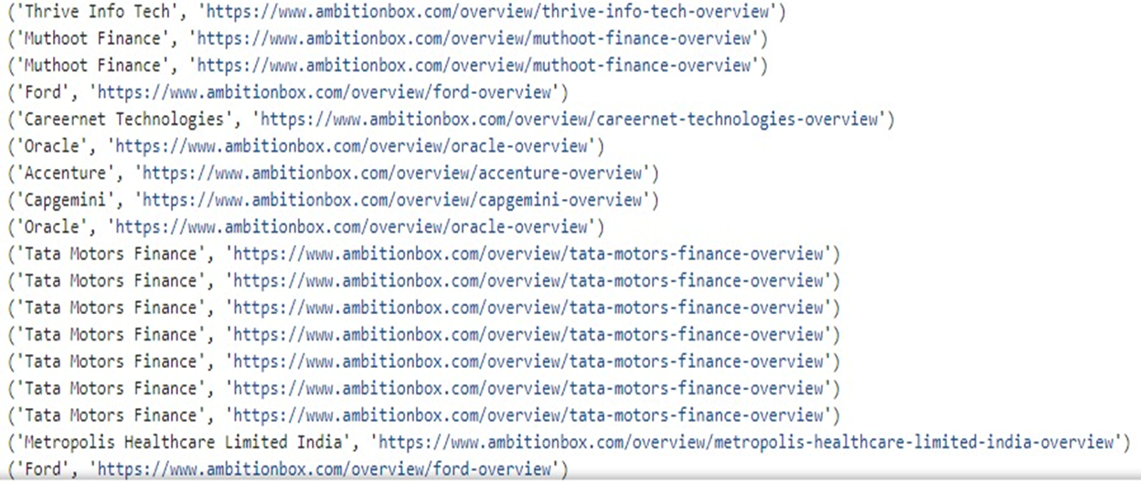

Slide 8
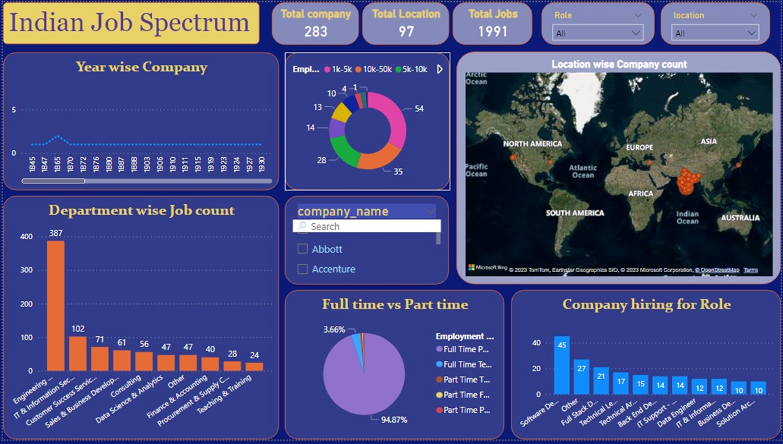

Slide 9

Challenges:
Learning of a new skill : Web Scrapping
Scrapping of large amounts of data
Stable Network Connection
Needed to ensure that the data collected is reliable, valid, and unbiased to avoid making incorrect decisions based on inaccurate information.

Slide 10
Conclusion
IN CONCLUSION, JOB ANALYSIS IS A CRITICAL PROCESS THAT ORGANIZATIONS MUST UNDERTAKE TO ENSURE THAT THEY HAVE THE RIGHT PEOPLE IN THE RIGHT POSITIONS. BY CONDUCTING A JOB ANALYSIS PROJECT, EMPLOYERS CAN IDENTIFY THE KNOWLEDGE, SKILLS, AND ABILITIES REQUIRED FOR EACH JOB, WHICH CAN HELP THEM MAKE INFORMED DECISIONS ABOUT RECRUITMENT, TRAINING, AND PERFORMANCE MANAGEMENT.

Slide 11

THANK'S FOR WATCHING

